Slide 1
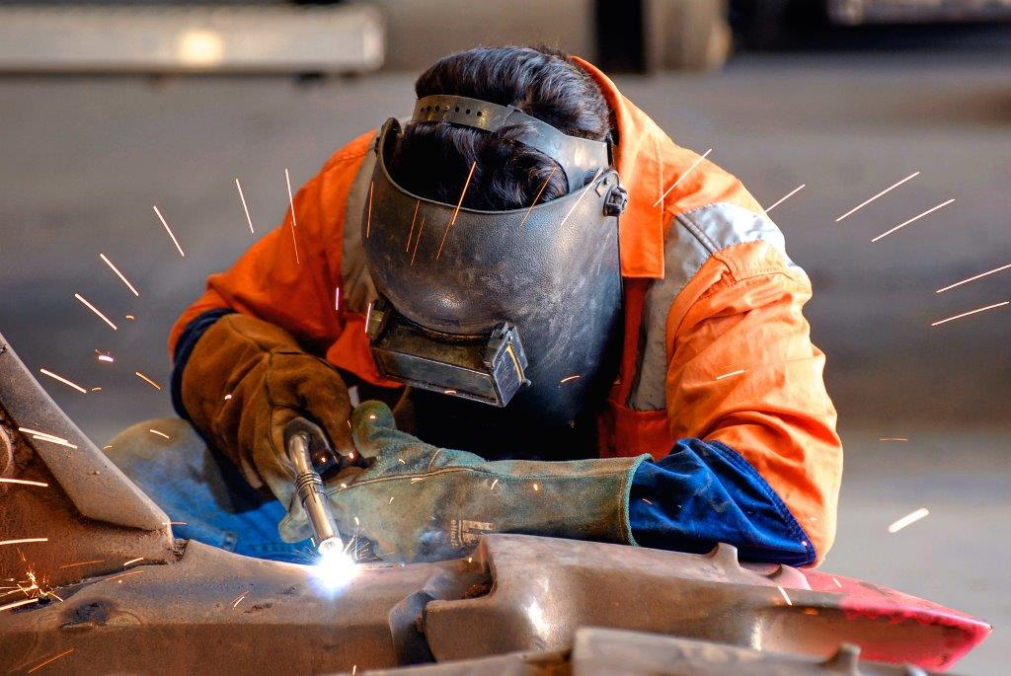
GAS WELDING

Slide 2
Def :
Welding is a process by which two materials, usually metals, are permanently joined together by with or without application of heat, with or without application of pressure and with or without application of filler material.
Welding (positive process)
Machining (negative process)
Forming, Casting (zero process)

Slide 3
Requirement for a high quality welding
A source of satisfactory heat and/or pressure,
A means of protecting or cleaning the metal, and
Caution to avoid or compensate for harmful metallurgical effects.

Slide 4
Welding
Solid State
Explosive
Liquid State
(Fusion)
Solid/Liquid State
Brazing
Ultrasonic
Forge
Diffusion
Friction
Soldering
Braze Welding
Arc
Resistance
Chemical
Gas Welding
Thermit

Slide 5
Weldability/ Fabrication Processes
The weldability of a material will depend on the specific welding or joining process being considered.
For resistance welding of consistent quality, it is usually necessary to remove the oxide immediately before welding.
Fabrication weldability test is used to determine mechanical properties required for satisfactory performance of welded joint.
The correct sequence of the given materials in ascending order of their weldability is
Aluminum < copper < cast Iron < MS

Slide 6
Gas Welding:
Heat source is the flame produced by the combustion of a fuel gas and oxygen.
Gas Welding has largely been replaced by other processes but it is still popular because of its portability and the low capital investment.
Acetylene is the principal fuel gas employed.
Combustion of oxygen and acetylene (C₂H₂) in a welding torch produces a temp. in a two stage reaction.
In the first stage
C₂H₂ + O₂ → 2CO + H₂ + Heat
This reaction occurs near the tip of the torch.
In the second stage combustion of the CO and H₂ takes place.
2CO + O₂ → 2CO₂ + Heat
H₂ + 1/2O₂ → H₂O + Heat
Oxygen for secondary reactions is obtained from the atmosphere.

Slide 7
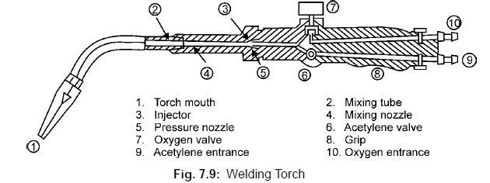
Gas Welding Torch

Slide 8
Types of Flame :
Three types of flames can be obtained by varying the oxygen/acetylene (or oxygen/fuel gas) ratio.
Neutral Flame :
If the ratio is about 1 : 1 to 1.15 : 1, all reactions are carried to completion and a neutral flame is produced.
Most welding is done with a neutral flame. It is chemically neutral and neither oxidizes or carburizes the metal being welded.

Slide 9
2. Oxidizing Flame :
A higher ratio, such as 1.5 : 1, produces an oxidizing flame, hotter than the neutral flame (about 3300ºC) but similar in appearance.
It is used when welding copper and copper alloys but harmful when welding steel because the excess oxygen reacts with the carbon, decarburizing the region around the weld.

Slide 10
3. Carburizing/ Reducing Flame :
Excess fuel, on the other hand, produces a carburizing flame. Carburizing flame can carburize metal also.
The excess fuel decomposes to carbon and hydrogen, and the flame temperature is not as great (about 3000ºC).
Flames of this type are used in welding Monel (a nickel‐copper alloy), high‐carbon steels, and some alloy steels, and for applying some types of hard‐facing material.

Slide 11
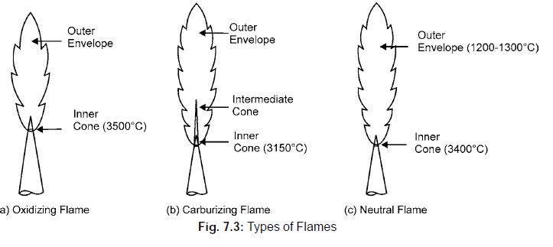

Slide 12
Oxy acetylene welding equipment
Oxygen is stored in a cylinder at a pressure ranging from 13.8 MPa to 18.2 MPa .
Due to high explosiveness of free acetylene it is stored in a cylinder with 80‐85% porous calcium silicate and then filled with acetone which absorb upto 420 times by its volume at a pressure 1.75 MPa .
At the time of acetylene release if acetone comes with acetylene the flame would give a purple colour.

Slide 13
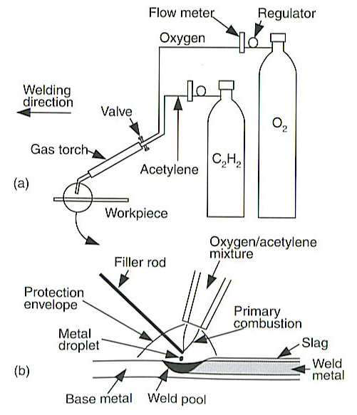

Slide 14
Uses, Advantages, and Limitations :
No pressure is involved.
Filler metal can be added in the form of a wire or rod.
Fluxes may be used to clean the surfaces and remove contaminating oxide. The gaseous shield produced by vaporizing flux can prevent oxidation during welding, and the slag produced by solidifying flux can protect the weld pool.
Exposer of the heated and molten metal to the various gases in the flame and atmosphere makes it difficult to prevent contamination.
Heat source is not concentrated, a large area of the metal is heated and distortion is likely to occur.
Flame welding is still quite common in field work, in maintenance and repairs, and in fabricating small quantities of specialized products.

